Slide 1
Agenda: Spring Security
Recap: Spring MVC (XML Based Configuration)
Spring MVC (Java Based Configuration)
Introduction to Security
Basic Authentication (XML Based & Java Based Configuration)
Default Form Authentication (XML Based & Java Based Configuration )
Custom Form Authentication (XML Based & Java Based Configuration)
Auth Providers (Hashed Password)
JDBC-User-Service

Slide 2
Recap: Spring MVC (XML Based Configuration)
Dynamic Web Project
Add all required .jar files (spring mvc libs)
Configure DispatcherServlet in web.xml (Deployment Descriptor)
Configure <<servlet-name>>-servlet.xml for DispatcherServlet
Define Controller class with @Controller
Define methods for GET, POST,PUT methods
Create View pages (.jsp)

Slide 3
Program 1 (using xml)
Let’s show a HTML page with a text field and a button
When the user enters his/her name and clicks the button, a jsp page will be shown with the message “Hello <<name>>”
The HTTP request is: /ofss/hello
Here, the servlet URL-pattern is /ofss/*

Slide 4
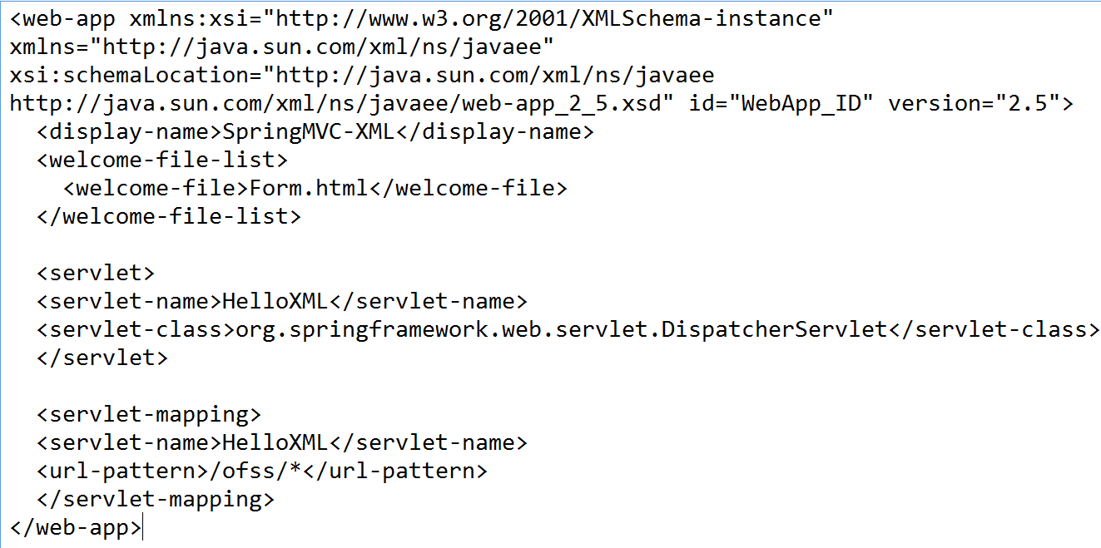
Program 1 (using xml)
web.xml

Slide 5
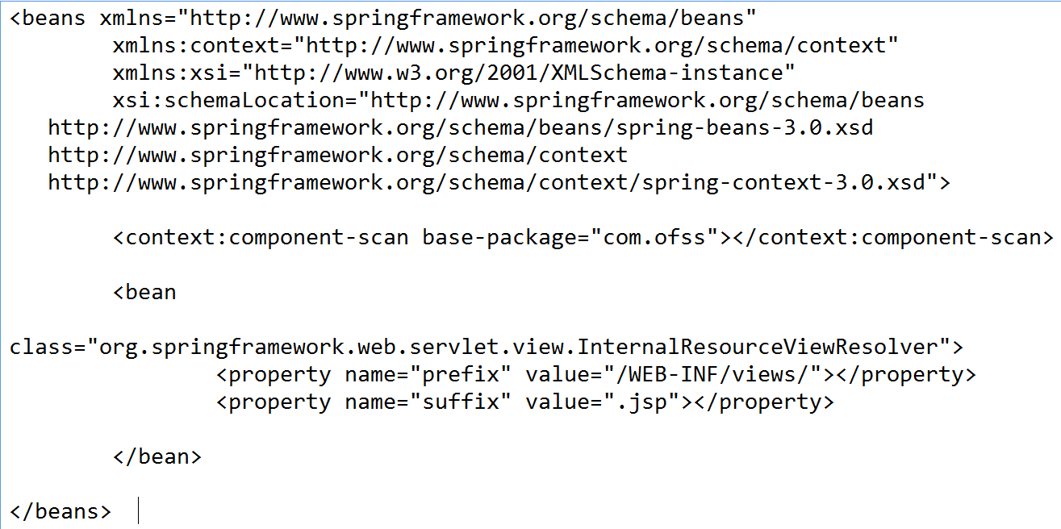
Program 1 (using xml)
HelloXML-servlet.xml (under WEB-INF)

Slide 6
Program 1 (using xml)
View (/WEB-INF/views/hello.jsp)
<html>
<head>
<title>Spring MVC XML Demo</title>
</head>
<body>
Hello ${msg}
</body>
</html>

Slide 7
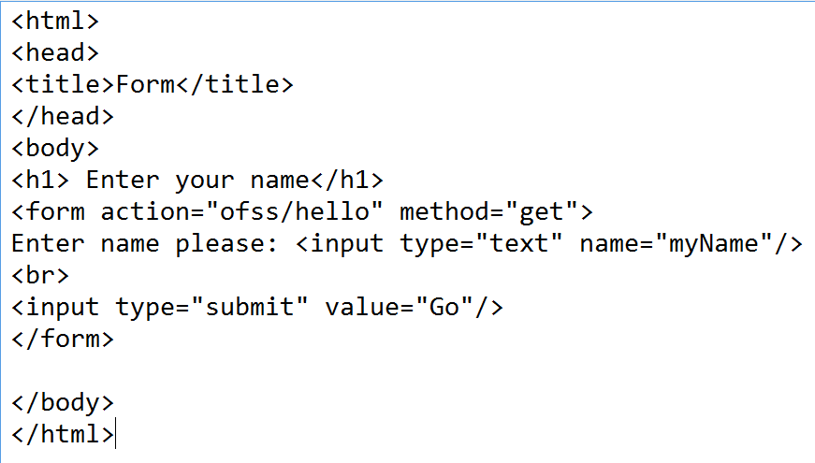
Program 1 (using xml)
Form.html

Slide 8
Program 2 (using Java Configuration)
Let’s show a HTML page with a text field and a button
When the user enters his/her name and clicks the button, a jsp page will be shown with the message “Hello <<name>>”
The HTTP request is: /hello
Here, the servlet URL-pattern is /

Slide 9
Program 2 (using Java Configuration)
There are no xml files in this method
So, We need to write a Java class for replacing web.xml
Also, need to write another Java class for replacing <<servlet>>-servlet.xml
Let’s see the controller classes and views
In this example, let’s show index.jsp for the request “/” (Root context)
So, we are not going to write any html pages

Slide 10
Program 2 (using Java Configuration)
Please make sure you add spring library that supports Java Based configuration and annotations
For this demo, we are using spring MVC version 5.0.2
The libraries are already available in the google drive link
Download and save to local D:\spring-web-security-lib-v5

Slide 11
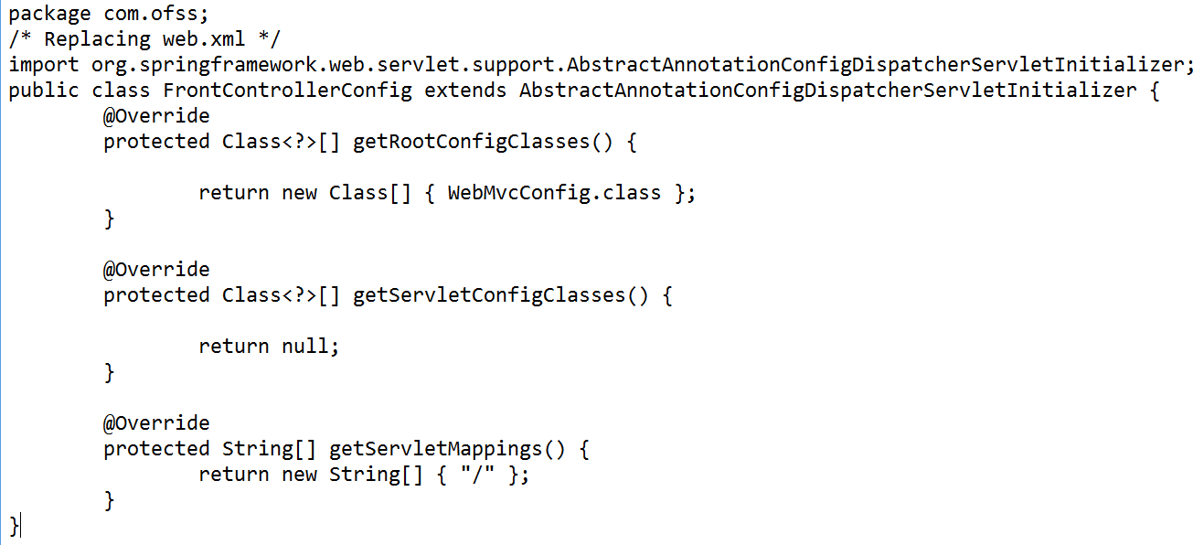
Program 2 (using Java Configuration)
Let’s call it FrontController.java (replacement of web.xml)
Used to register a DispatcherServlet
Java-based Spring configuration.

Slide 12
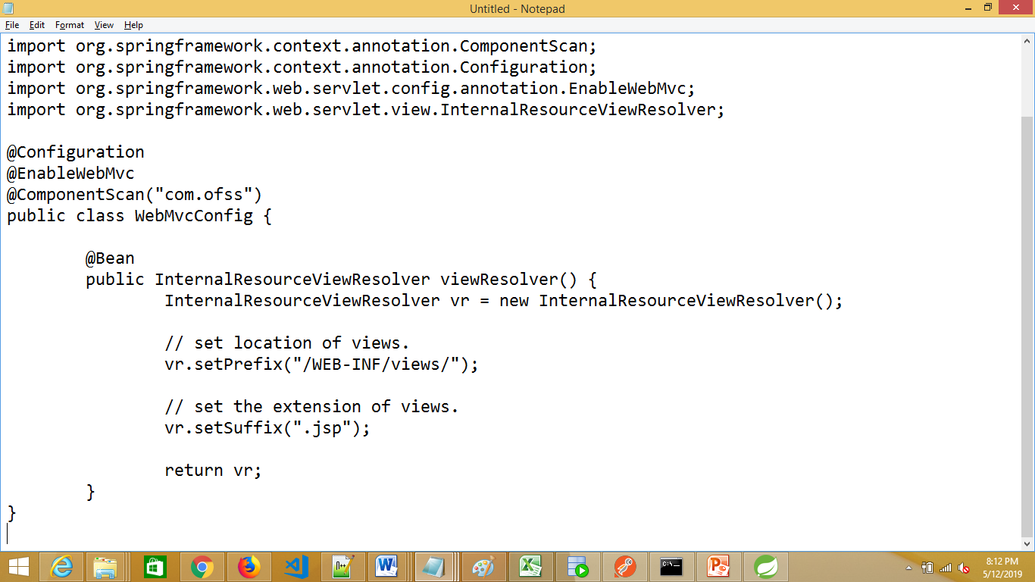
Program 2 (using Java Configuration)
Let’s create another class WebMvcConfig.java for replacing
<<servlet-name>>-servlet.xml (for view resolver and handler mapping)

Slide 13
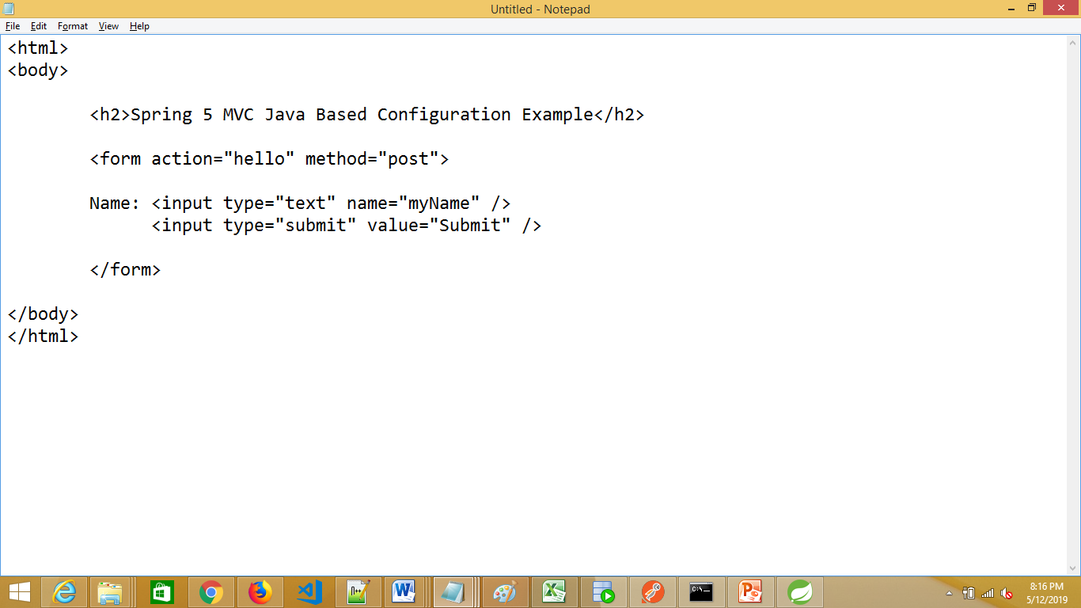
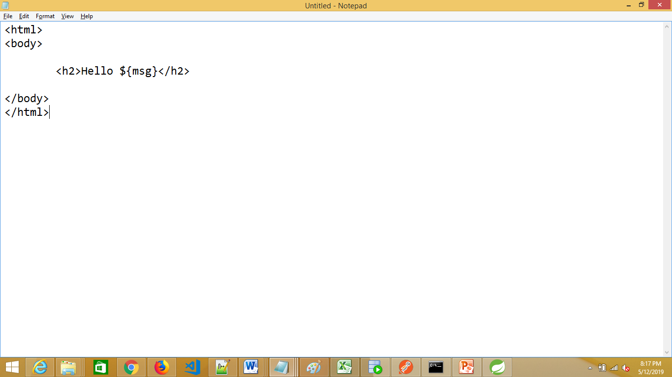
Program 2 (using Java Configuration)
Views (/WEB-INF/index.jsp & /WEB-INF/welcome.jsp):

Slide 14
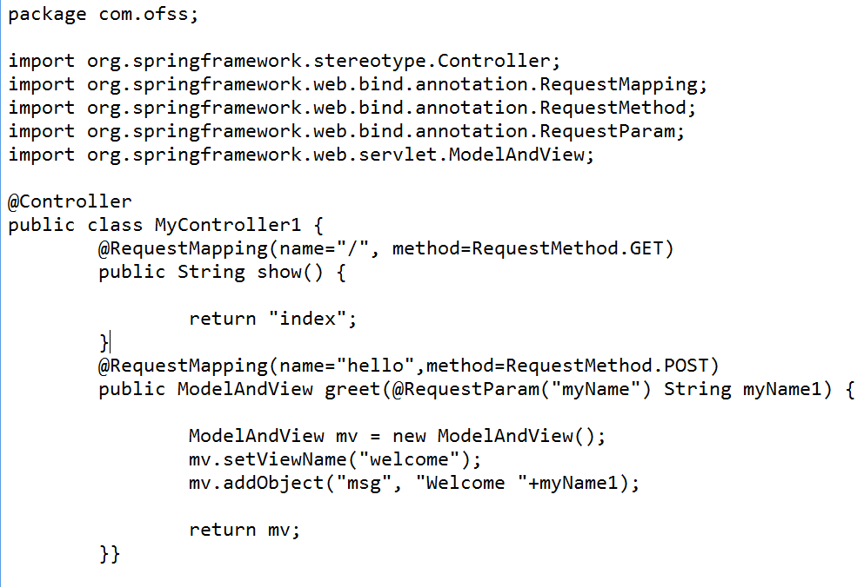
Program 2 (using Java Configuration)
Controller class:

Slide 15
Introduction to Spring Security
Spring Security is a framework that provides
authentication,
authorization, and
protection against common attacks. With first class support for both imperative and reactive applications, it is the de-facto standard for securing Spring-based applications.

Slide 16
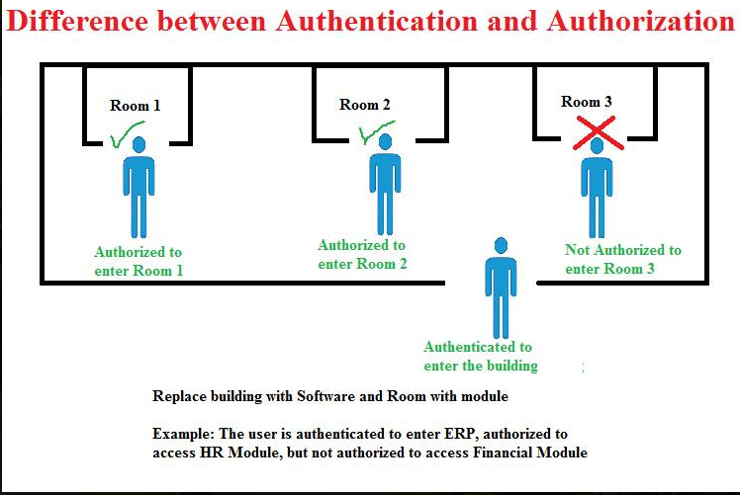
Authentication and Authorization

Slide 17
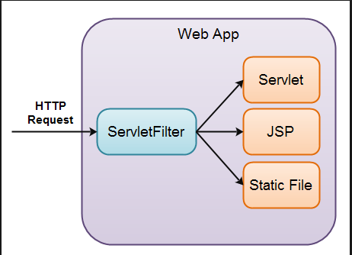
Understanding servlet filter

Slide 18
Spring Security
Spring Security starts with DelegatingFilterProxy
It is a servlet filter that allows passing control to Filter classes that have access to the Spring application context.
Spring Security relies on this technique heavily.

Slide 19
Spring Security – xml configuration
In web.xml, we need to configure
DispatcherServlet
ContextLoaderListener
DelegatingFilterProxy

Slide 20
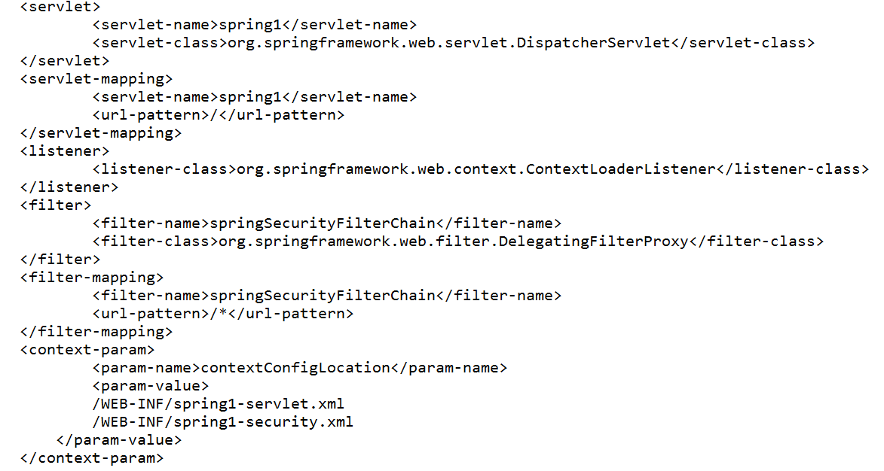
Spring Security – xml configuration (web.xml)

Slide 21
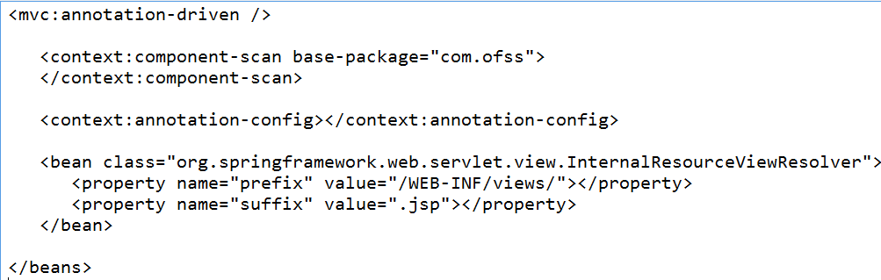
Spring Security – xml configuration (spring1-servlet.xml)
There is no extra details required in this.
We have the same standard contents

Slide 22
Spring Security – xml configuration (spring1-security.xml)
This file contains the information about which URL request needs to be secured and who /which role (admin, dba, user) can access this
It also mentions about type of authentication provider like user-service or jdbc-user-service
For user-service: we need to mention the authority name (role name) like “admin”, “dba”, “user” etc and username and password

Slide 23
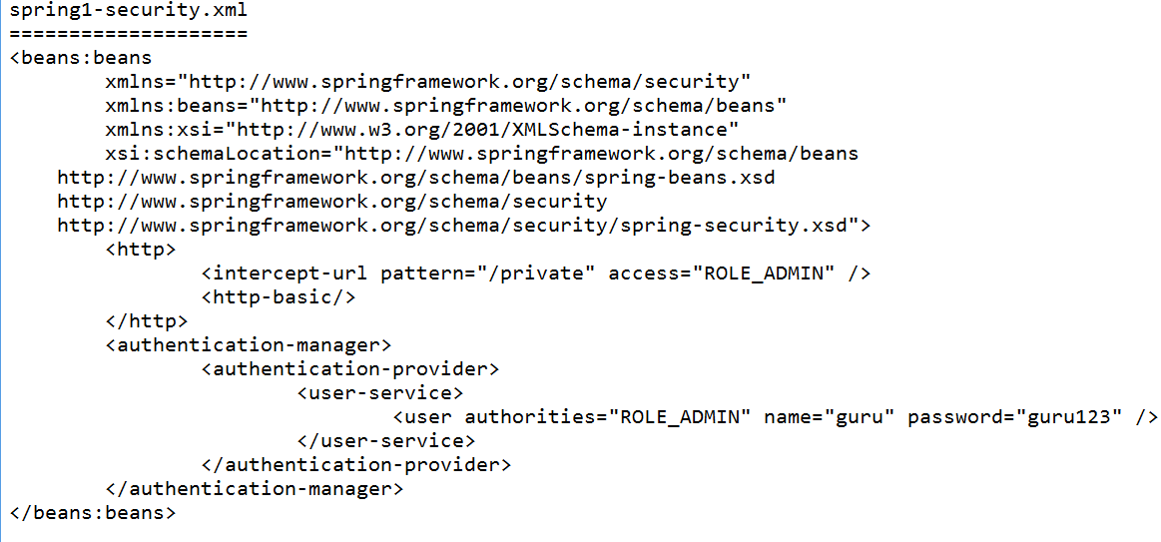
Spring Security – xml configuration (spring1-security.xml)

Slide 24
Program 4: Spring Security - Basic Authentication:
Let’s create a Spring MVC application
It contains two web pages
public.jsp: Accessible to all
private.jsp: Can be accessed by the user who has role as “ROLE_ADMIN”
Let’s say the user “guru” belongs to this role and his password is “guru123”
When you access private.jsp page, the security windows should popup and ask for the credentials

Slide 25
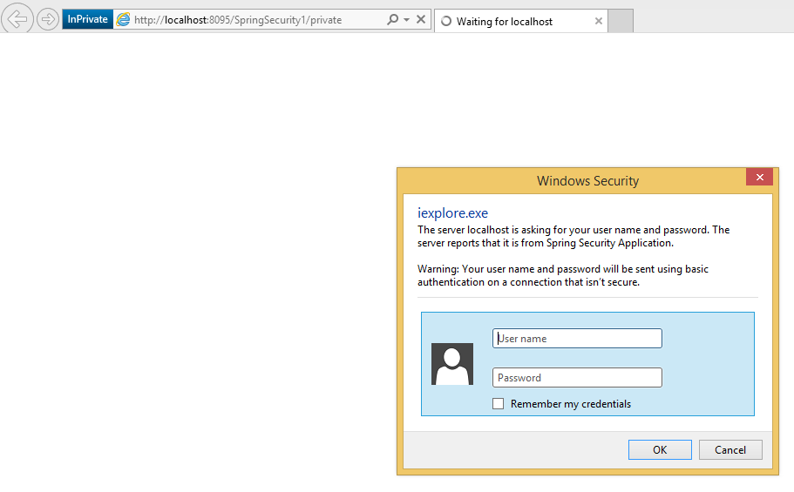
Program 4: Spring Security - Basic Authentication:

Slide 26
Program 4: Spring Security - Basic Authentication:
Create Dynamic Web Project Name: SpringSecurity1 (Select Apache Tomcat version 8.5)
Select web module version 2.5 and select apache tomcat 8.5
Copy the required jar files to WEB-INF\lib folder (D:\spring-security-web-v3.0.5)

Slide 27
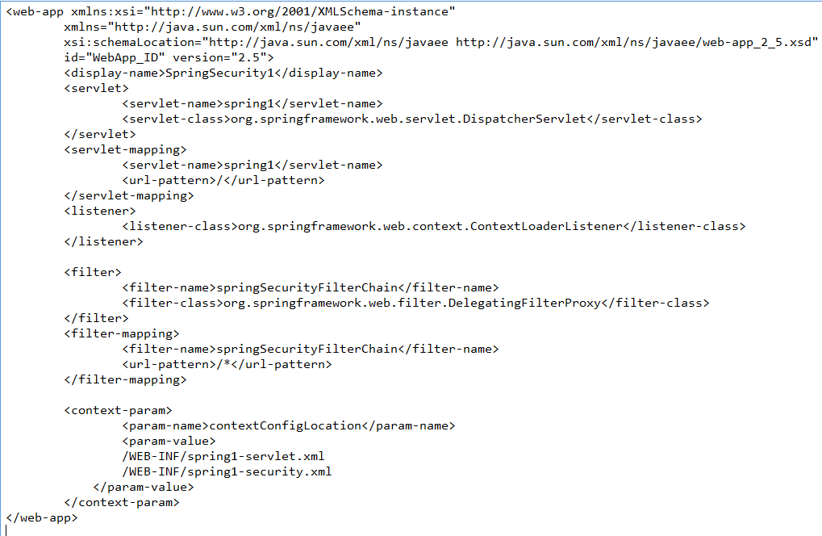
Program 4: Spring Security - Basic Authentication (web.xml)

Slide 28
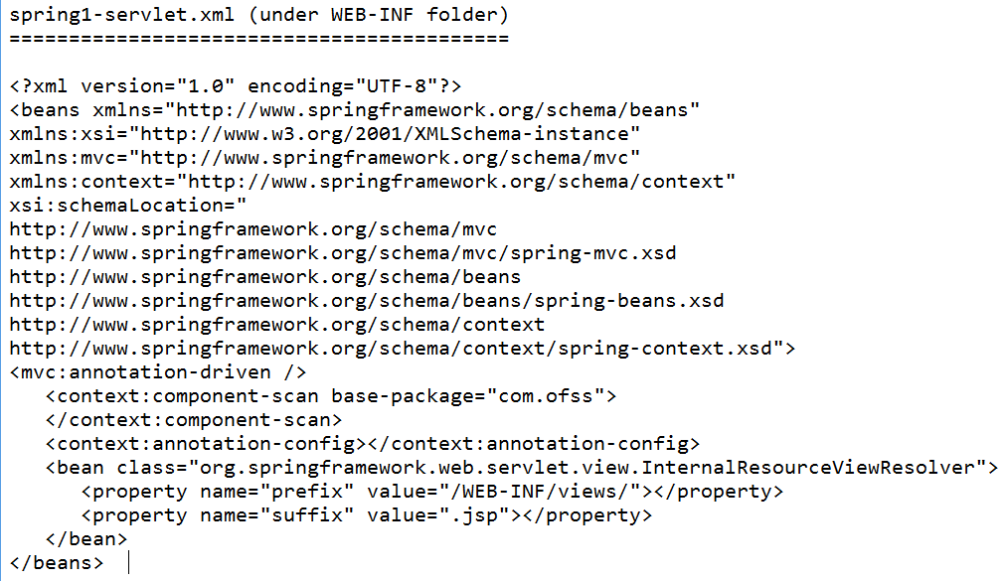
Program 4: Spring Security - Basic Authentication (spring1-servlet.xml)

Slide 29

Program 4: Spring Security - Basic Authentication (spring1-security.xml)

Slide 30
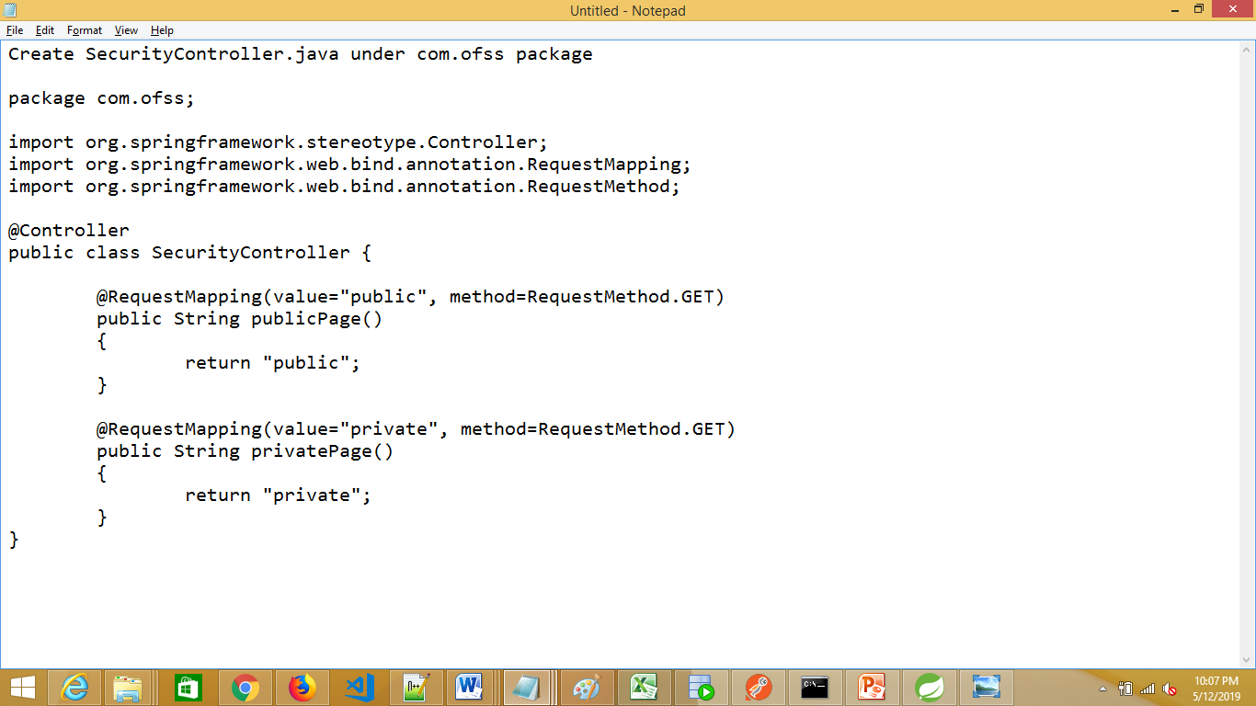
Program 4: Spring Security - Basic Authentication : Controller class

Slide 31
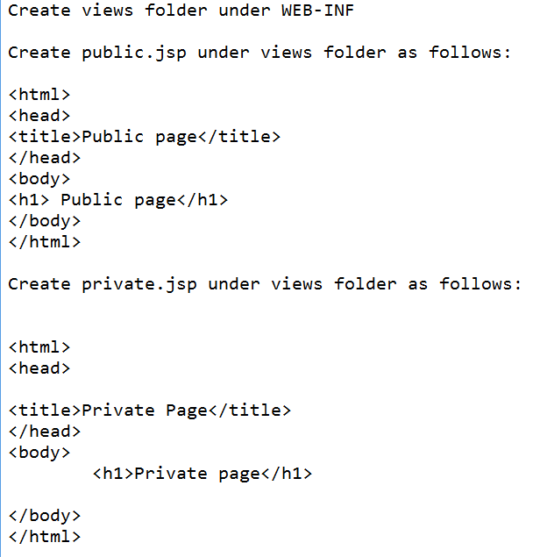
Program 4: Spring Security - Basic Authentication : Views

Slide 32
Program 4: Spring Security - Basic Authentication : Running the application
Right click the project...Run as....Run on server .... select Tomcat version 8.5
When the browser opens: enter: http://localhost:8095/SpringSecurity1/public
It should display the public.jsp page
Enter: http://localhost:8095/SpringSecurity1/private
It should ask the username and password: guru and guru123

Slide 33
Program 4: Spring Security - Basic Authentication - Displaying the user who logged in
Modify private.jsp as follows:
<html>
<head>
<title>Private Page</title>
</head>
<body>
<h1>Private page</h1>
<h1> ${msg}</h1>
</body>
</html>

Slide 34
Program 4: Spring Security - Basic Authentication - Displaying the user who logged in
Modify SecurityController.java as follows:
The method privatePage should be updated as follows:
import java.security.Principal;
@RequestMapping(value="private", method=RequestMethod.GET)
public String privatePage(Principal principal,ModelMap map)
{
String msg="Hello "+principal.getName();
map.addAttribute("msg",msg);
return "private";
}

Slide 35
Program 5: Spring Security – Default Form Authentication:
The same application
But, we will be using default form to enter the credentials instead of security window popup by the operating system
The default form is provided by Spring framework

Slide 36
Program 5: Spring Security – Default Form Authentication:
Just change in spring1-security.xml file as follows:
<http>
<intercept-url pattern="/private" access="ROLE_ADMIN" />
<form-login/>
</http>

Slide 37
Program 5: Spring Security – Default Form Authentication:
Run the application
When you enter the URL: http://localhost:8095/SpringSecurity1/spring_security_login
It should display the default form
If the username and password is invalid, it also display a default error message and the user is routed back to the default login page

Slide 38
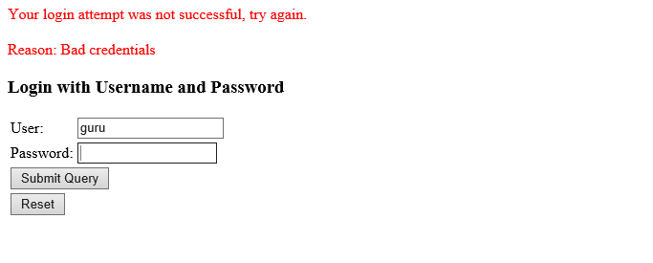
Program 5: Spring Security – Default Form Authentication:

Slide 39
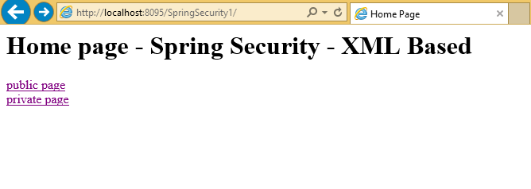
Program 5: Spring Security – Default Form Authentication – Routing to public and private pages through Home page

Slide 40
Program 5: Spring Security – Default Form Authentication – Routing to public and private pages through Home page
Add the following method in SecurityController.java
@RequestMapping(value="/", method=RequestMethod.GET)
public String home()
{
return "home";
}

Slide 41
Program 5: Spring Security – Default Form Authentication – Routing to public and private pages through Home page
Add home.jsp:
<html>
<head>
<title>Home Page</title>
</head>
<body>
<h1>Home page - Spring Security - XML Based </h1>
<a href="http://localhost:8095/SpringSecurity1/public">public page</a> <br>
<a href="http://localhost:8095/SpringSecurity1/private">private page</a>
</body>
</html>

Slide 42
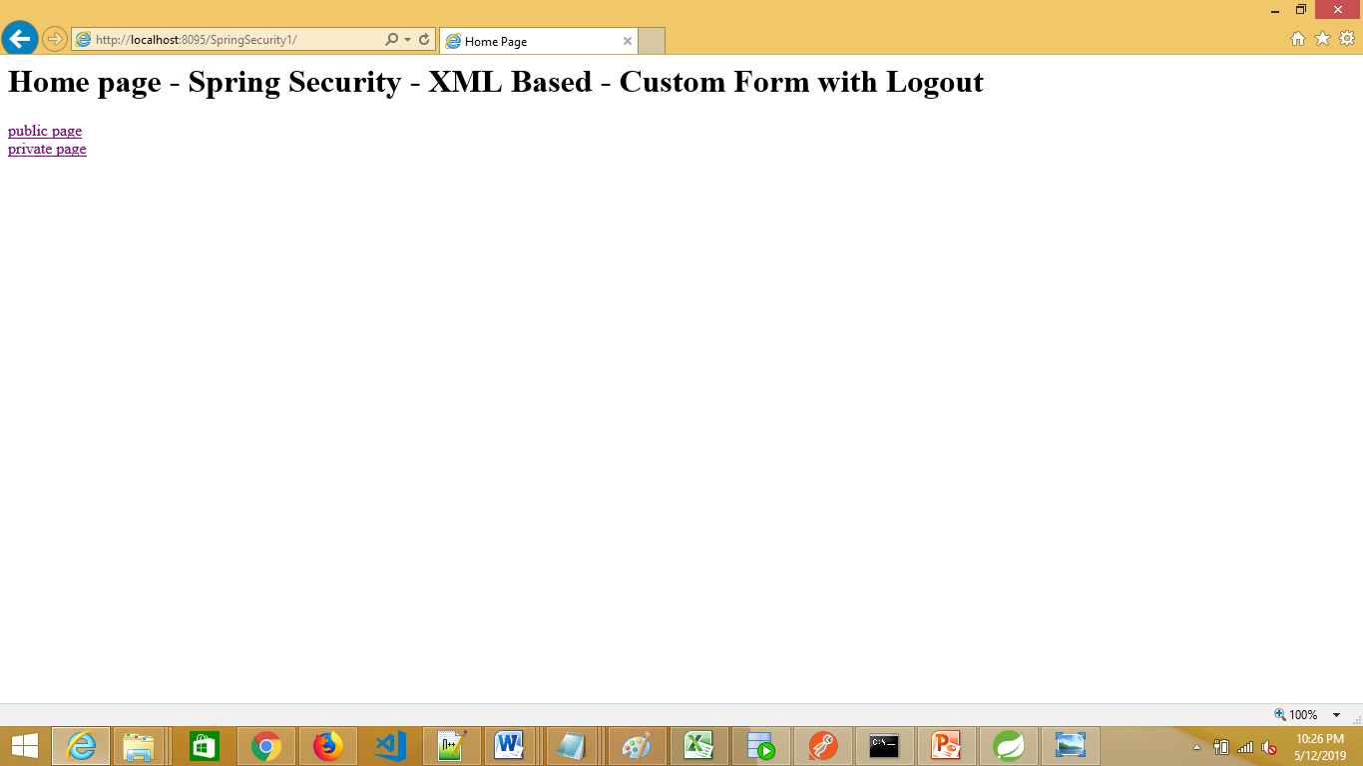
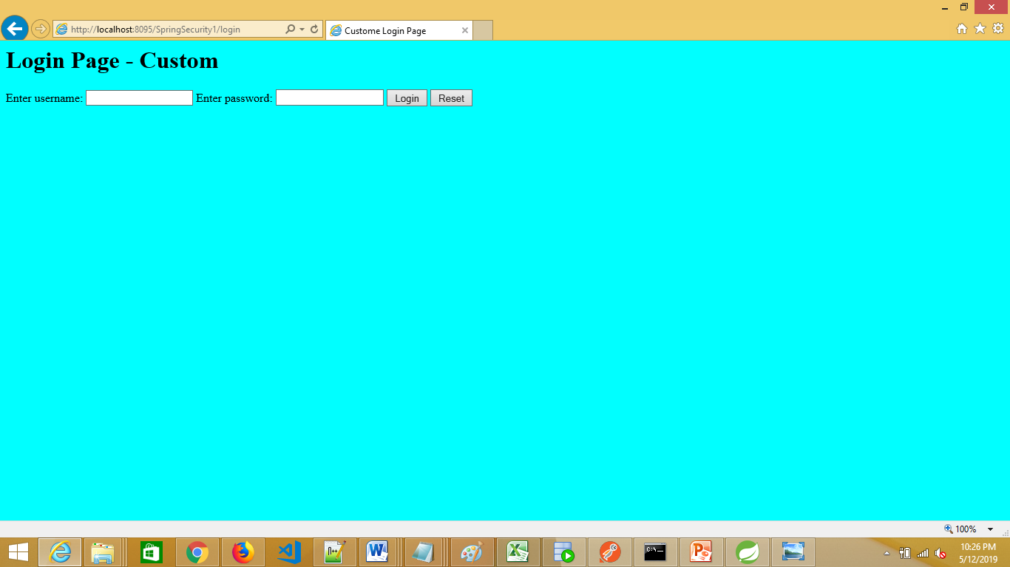
Program 6: Spring Security – Custom Form Authentication with Logout

Slide 43
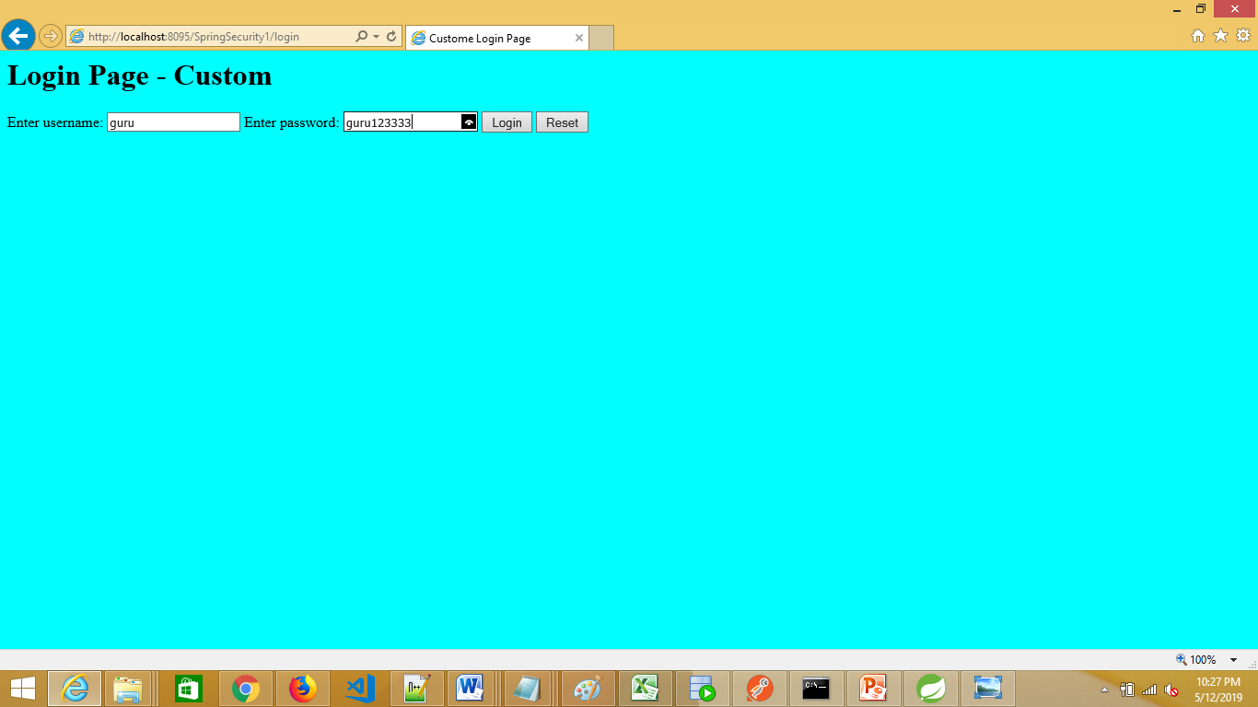
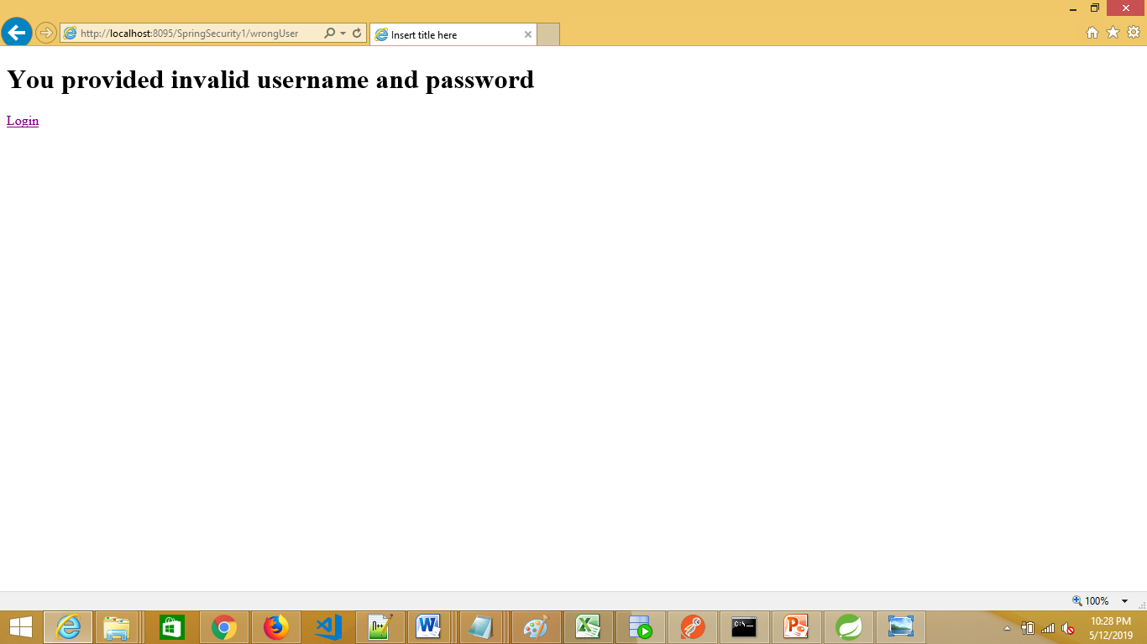
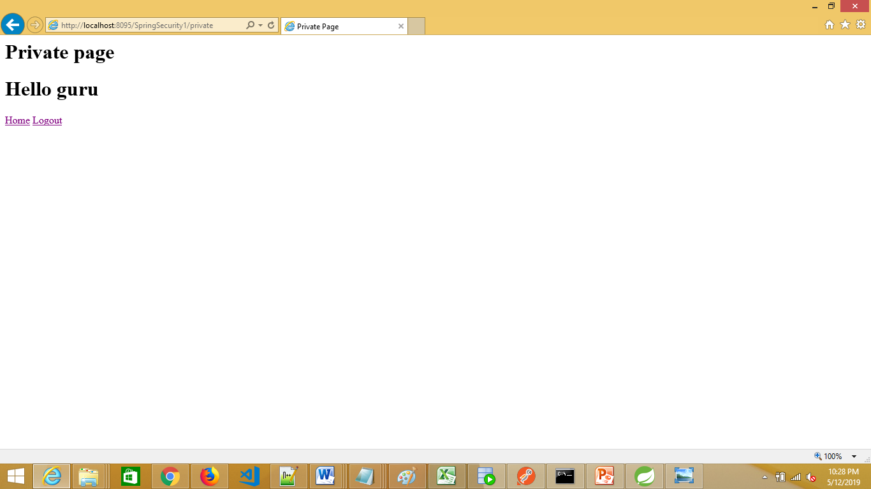
Program 6: Spring Security – Custom Form Authentication with Logout

Slide 44
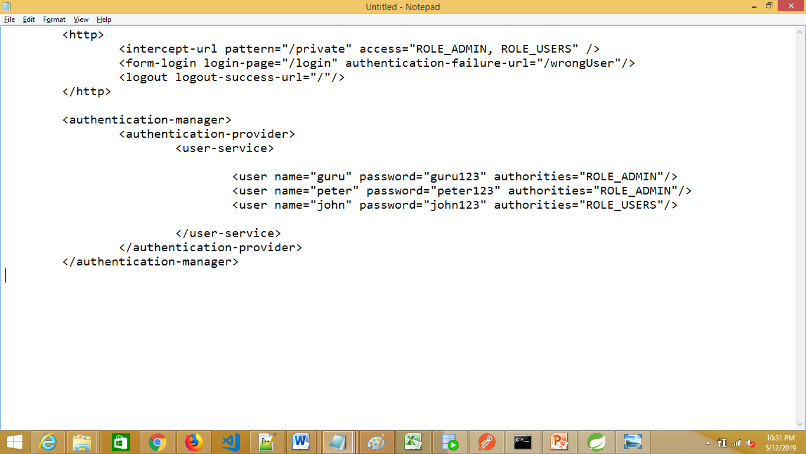
Program 6: Spring Security – Custom Form Authentication with Logout
spring1-security.xml:

Slide 45
Program 6: Spring Security – Custom Form Authentication with Logout
SecurityController.java
In this class, we need to have methods to map the follows requests:
/public: Shows the pubic page (no authentication needed)
/private: Shows the Login page by Spring security
/ : Shows the home page contains two links: public & private
This is called as webapplication root context
/login: Shows the custom Login page by Spring security
/loginFailed: Shows the custom Login page by Spring security (you can configure whatever the page you want)
/logout: Shows the custom Login page by Spring security (you can configure whatever the page you want)
/wrongUser: Shows the page that displays invalid username and password
Refer the file “Programs - Spring Security.txt” for full code

Slide 46
Program 6: Spring Security – Custom Form Authentication with Logout
login.jsp
<form action="j_spring_security_check" method="post">
Enter username: <input type="text" name="j_username"/>
Enter password: <input type="password" name="j_password"/>
<input type="submit" value="Login"/>
<input type="reset" name="reset"/>
</form>
j_spring_security_check is a Servlet where the actual authentication is made and you must map the action of your login form to this Servlet.
j_username and j_password are standardized names in the Java Servlet specification, so the application servers (or servlet containers) know about them and can perform container authentication, independently of the application.

Slide 47
Program 6: Spring Security – Custom Form Authentication with Logout
private.jsp
<html>
<head>
<title>Private Page</title>
</head>
<body>
<h1>Private page</h1>
<h1> ${msg}</h1>
<a href="http://localhost:8095/SpringSecurity1">Home</a>
<a href="j_spring_security_logout">Logout</a>
</body>
</html>

Slide 48
Auth Providers: Hashed Password
Providing password as plain text is not secure
So, in this demo, we are going to see how to save the password in an encoded mechanism i.e. hashed password
Hashing performs a one-way transformation on a password, turning the password into another String, called the hashed password.
Hashing algorithms are used in cryptographic applications like a digital signature.
Hashing is used to generate random strings to avoid duplication of data stored in databases.
There are various hashing algorithms available to hash your passwords (such as MD4, SHA, RIPMEND, WHIRLPOOL, TIGER algorithms)

Slide 49
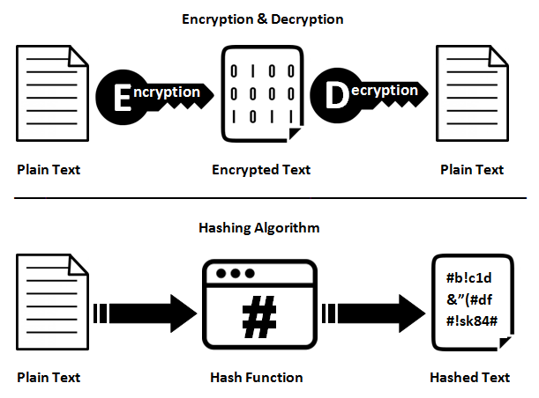
Encryption and Hashing

Slide 50
SHA: Generating hashed password
Before proceeding, let’s try an interesting program
We have the password, say “peter123”
This is the plain text
We want to generate a hashed password for this
Use this generated hashed password in spring1-security.xml

Slide 51
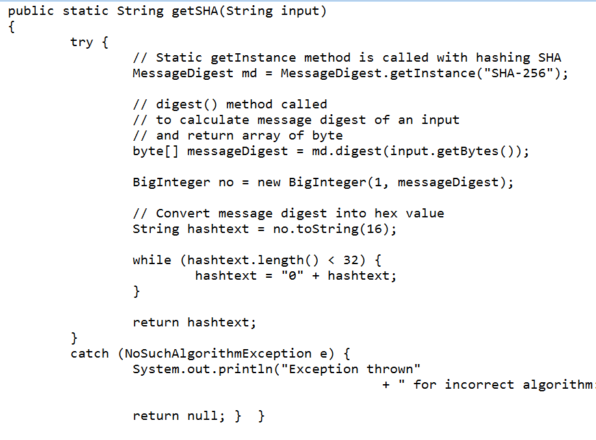
SHA: Generating hashed password Call this method from main method

Slide 52
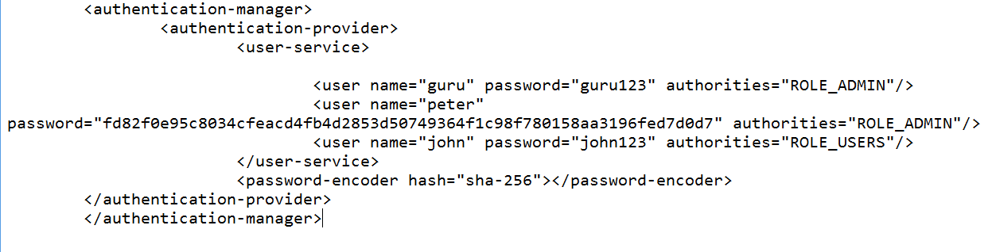
SHA: Using encoded password
This is the generated hashed password for the String “peter123”
fd82f0e95c8034cfeacd4fb4d2853d50749364f1c98f780158aa3196fed7d0d7
Now, we need to copy this encoded password in spring1-security.xml file

Slide 53
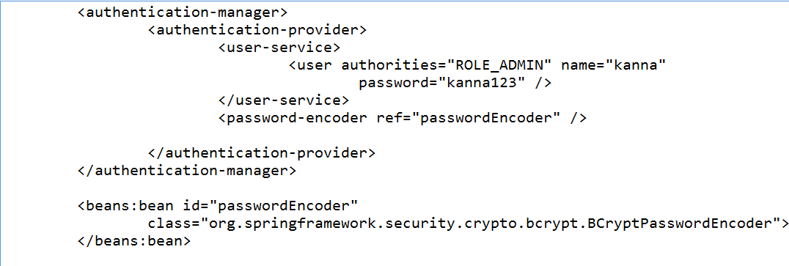
BCryptPasswordEncoder: Generating hashed password
Similarly, if you want to use BCryptPasswordEncoder, make the changes as below in spring1-security.xml file
But, this class is found in Spring security Version 5.x
So, you need to have this lib in your class path

Slide 54
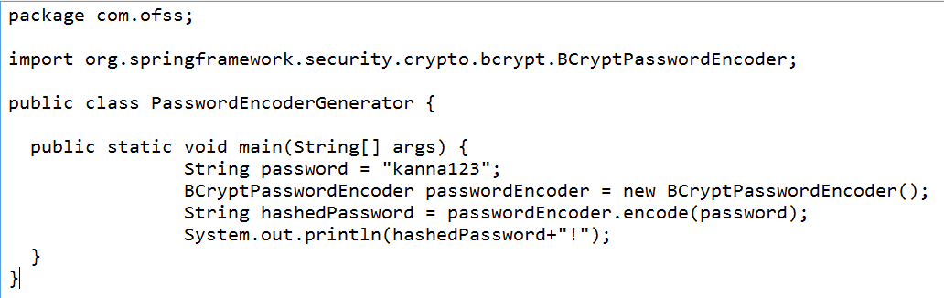
BCryptPasswordEncoder: Generating encoded password – Program
Similarly, if you want to use BCryptPasswordEncoder, make the changes as below in spring1-security.xml file
But, this class is found in Spring security Version 5.x
So, you need to have this lib in your class path

Slide 55
Program 7: Auth provider: jdbc-user-service
There is one more auth provider called jdbc-user-service
In this program, we are going to see how to authenticate our spring application against the credentials from a database table called “users”
For this, first we need to create the two tables: users and user_roles
Table user_roles contains two columns: username and role
Table users contains three columns: username, password, enabled

Slide 56
Program 7: Auth provider: jdbc-user-service: Creating tables
Create the following two tables:
========================
SQL> desc users;
Name Null? Type
----------------------------------------- -------- ----------------------------
USERNAME VARCHAR2(10)
PASSWORD VARCHAR2(10)
ENABLED NUMBER(1)
Records:
SQL> select * from users; (Some sample usernames)
USERNAME PASSWORD ENABLED
---------- ---------- ---------- ---------- ----------
kavana 123 1
SAIF 234 1
ASWINI 555 1
guru 123 1

Slide 57
Program 7: Auth provider: jdbc-user-service: Creating tables
SQL> desc user_roles;
Name Null? Type
----------------------------------------- -------- ----------------------------
USERNAME VARCHAR2(10)
ROLE VARCHAR2(10)
SQL> select * from user_roles;
USERNAME ROLE
---------- -------------------------------
kavana ROLE_ADMIN
ASWINI ROLE_ADMIN

Slide 58
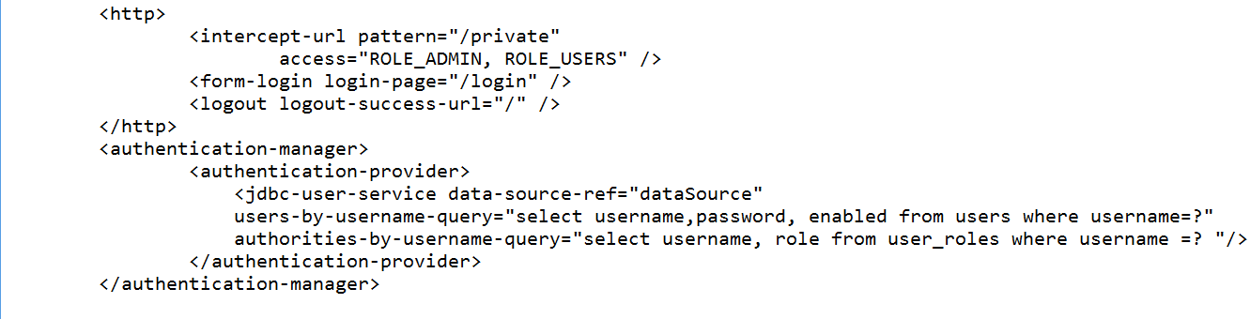
Program 7: Auth provider: jdbc-user-service: spring1-security.xml

Slide 59
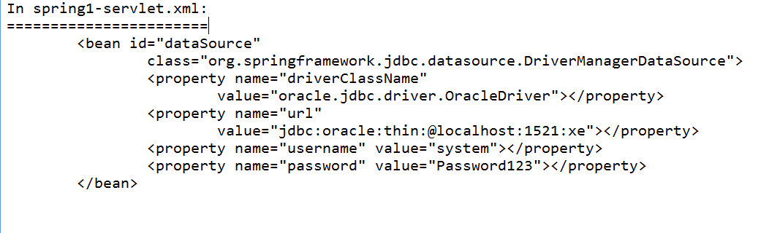
Program 7: Auth provider: jdbc-user-service: Defining DataSource
Don't forget to add "ojdbc5.jar" in case you are using ORACLE DB VERSION 11.x

Slide 60
Spring Security: Java Based Config
In this Java based configuration, we are not going to use xml files at all
For web.xml, we will be defining a java class (Call it MvcWebApplicationInitializer.java)
For <<servlet-name>>-servlet.xml file, we will be defining a java class (Call it WebMvcConfig.java)
For spring-security.xml file, we will be defining another java class (Call it WebSecurityConfig.java)
We will be creating SecurityWebApplicationInitializer.java for registering the DelegatingFilterProxy to use
the springSecurityFilterChain

Slide 61
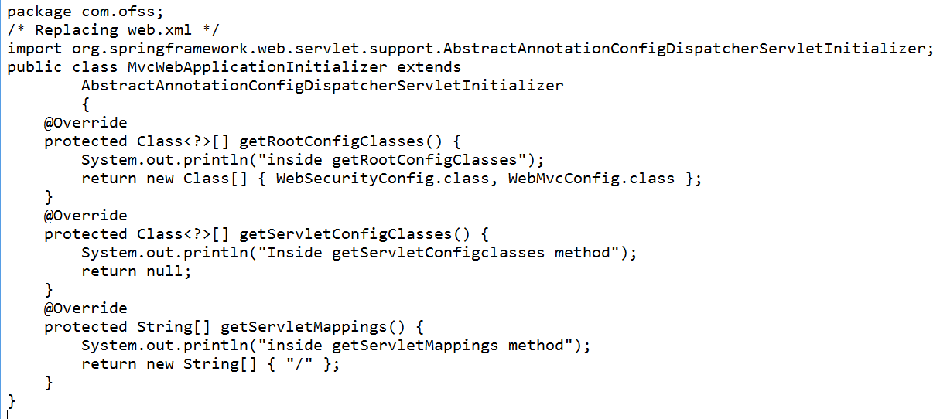
Program 8: Spring Security: Java Based Config Basic Authentication
Use Spring 5 libraries
Java class replacing web.xml:

Slide 62
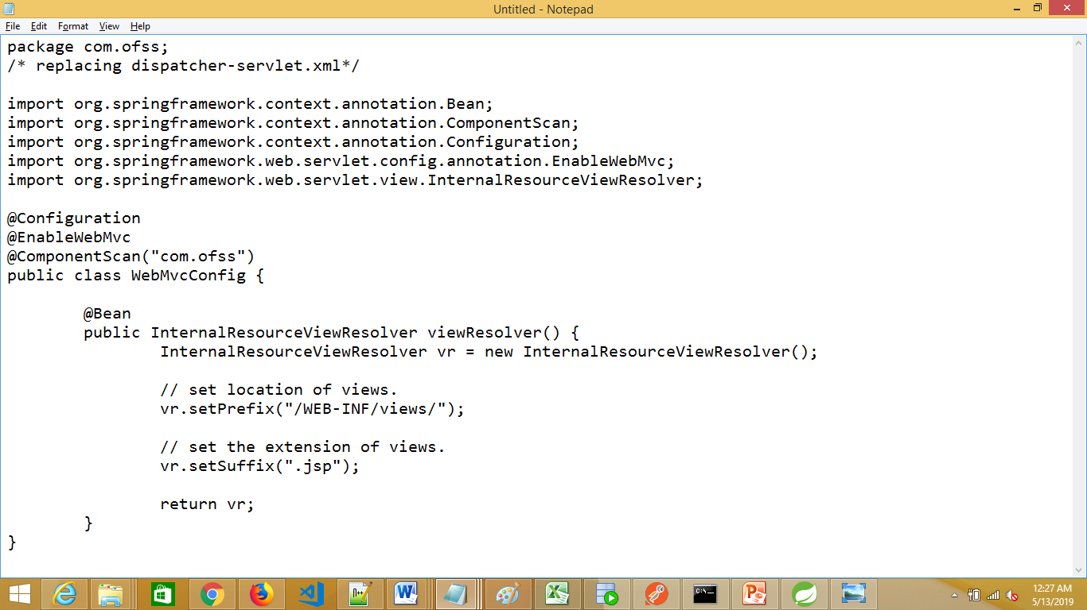
Program 8: Spring Security: Java Based Config Basic Authentication
Java class replacing <servlet-name>-servlet.xml

Slide 63
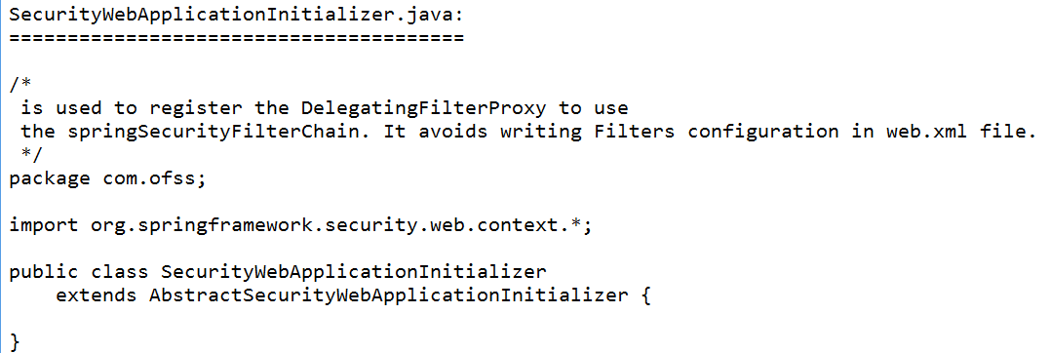
Program 8: Spring Security: Java Based Config Basic Authentication
Java class to register DelegatingFilterProxy
spring will detect the instance of this class during
application startup, and register the
DelegatingFilterProxy to use the springSecurityFilterChain
before any other registered Filter.
It also register a ContextLoaderListener.

Slide 64
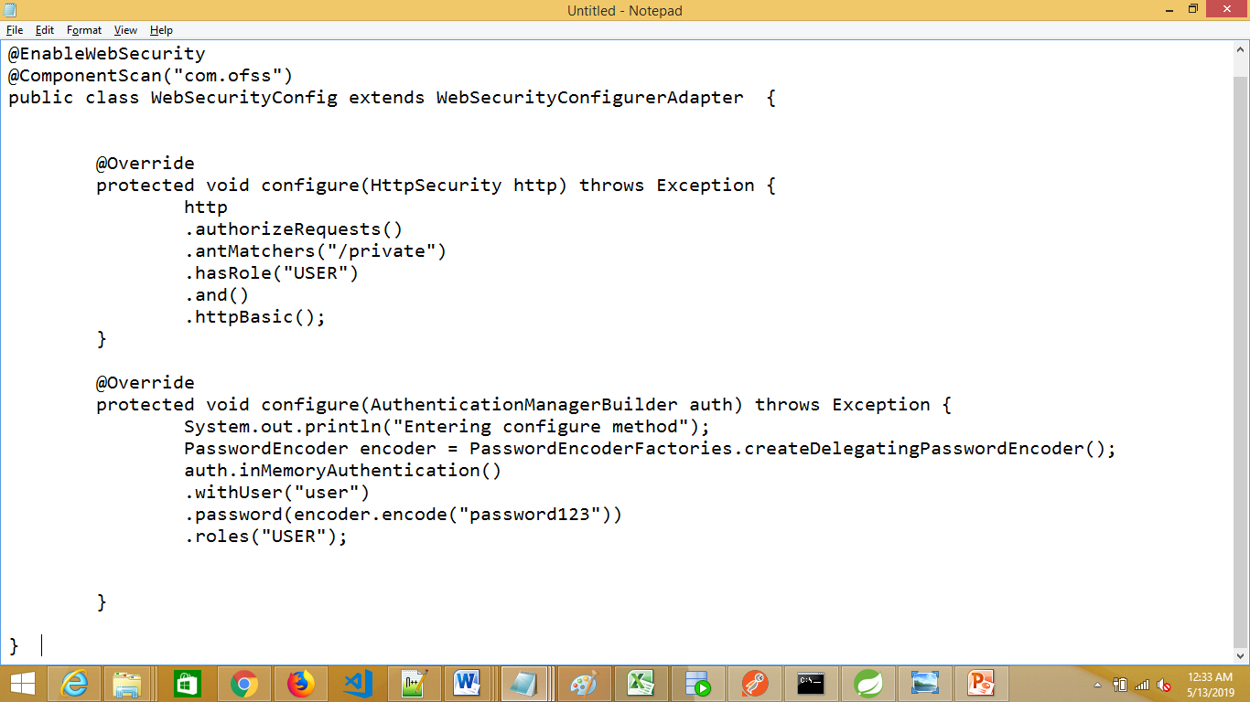
Program 8: Spring Security: Java Based Config Basic Authentication
Java class replacing spring1-security.xml

Slide 65
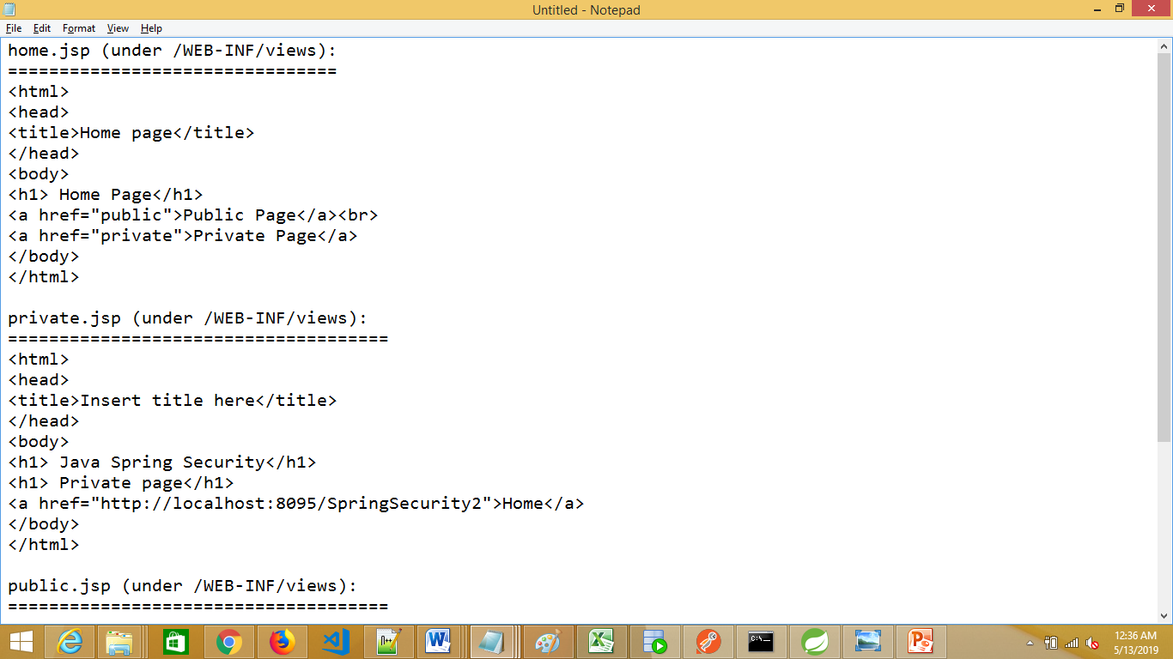
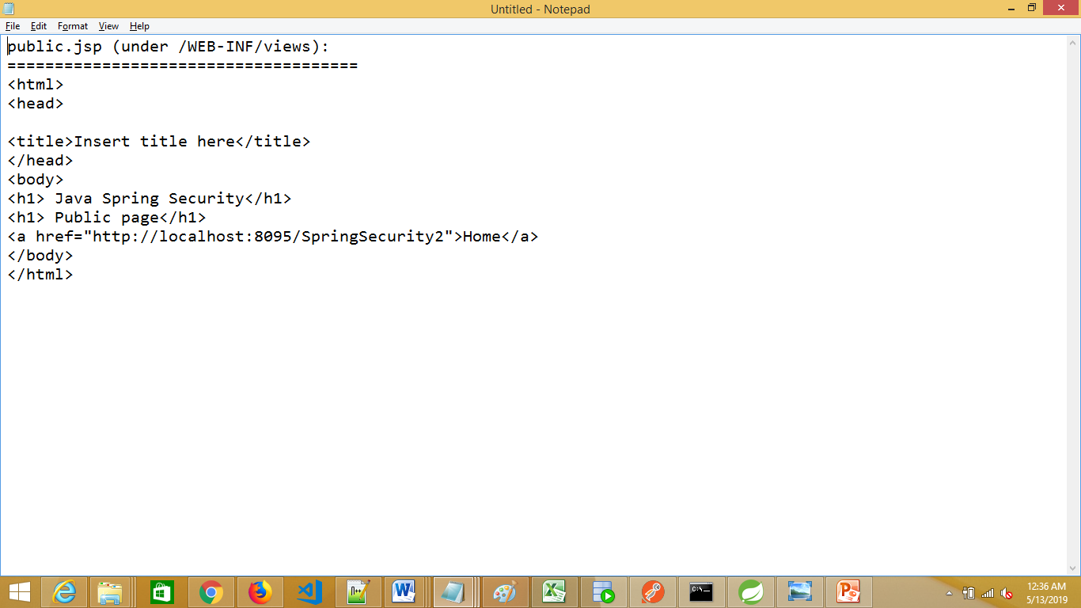
Program 8: Spring Security: Java Based Config Basic Authentication
Views (under /WEB-INF/views folder)

Slide 66
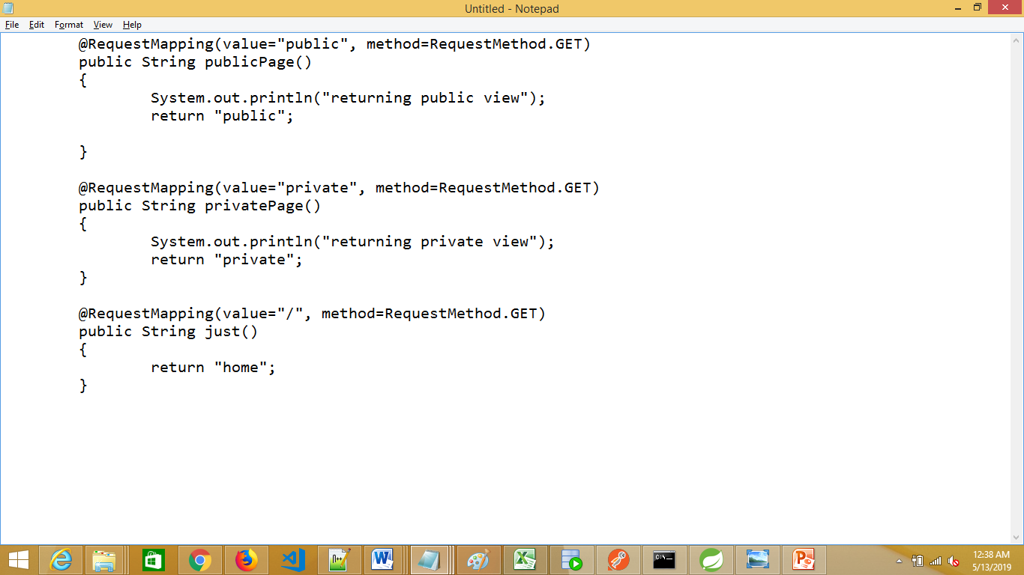
Program 8: Spring Security: Java Based Config Basic Authentication
Controller class

Slide 67
Program 9: Spring Security: Java Based Config Basic Authentication with PasswordEncoder
Introduce the following method in WebSecurityConfig.java:
@Bean
public PasswordEncoder passwordEncoder() {
return new BCryptPasswordEncoder();
}

Slide 68
Program 9: Spring Security: Java Based Config Basic Authentication with PasswordEncoder (BCryptPasswordEncoder)
Modify configure(AuthenticationManagerBuilder auth) method as follows:
@Override
protected void configure(AuthenticationManagerBuilder auth) throws Exception {
System.out.println("Entering configure method");
PasswordEncoder encoder = PasswordEncoderFactories.createDelegatingPasswordEncoder();
auth.inMemoryAuthentication()
.withUser("user")
.password("$2a$10$vCBmLuxmaa8qWYo3b9UpFO0c6LOpc4Rs57JyNAt6g9Ns8IsmH5CWq")
.roles("USER");
}

Slide 69
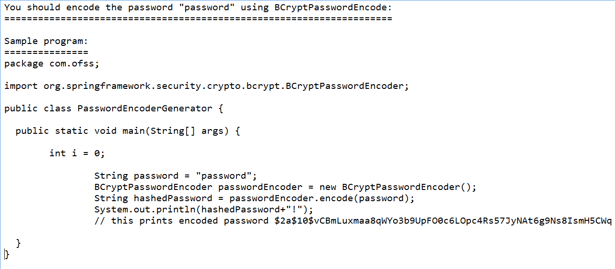
Program 9: Spring Security: Java Based Config – Generating encoded password

Slide 70
Program 10: Spring Security: Java Based Config Default form Authentication
Just change the following in WebSecurityConfig.java:
@Override
protected void configure(HttpSecurity http) throws Exception {
http
.authorizeRequests()
.antMatchers("/private")
.hasRole("USER")
.and()
.formLogin();
}

Slide 71
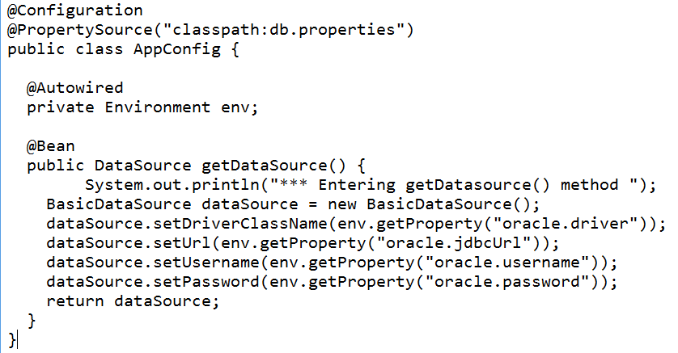
Program 11: Spring Security: Java Based Config JDBC Authentication
Let’s introduce one more Java class that gives the instance of DataSource class
Let’s call it as AppConfig.java

Slide 72
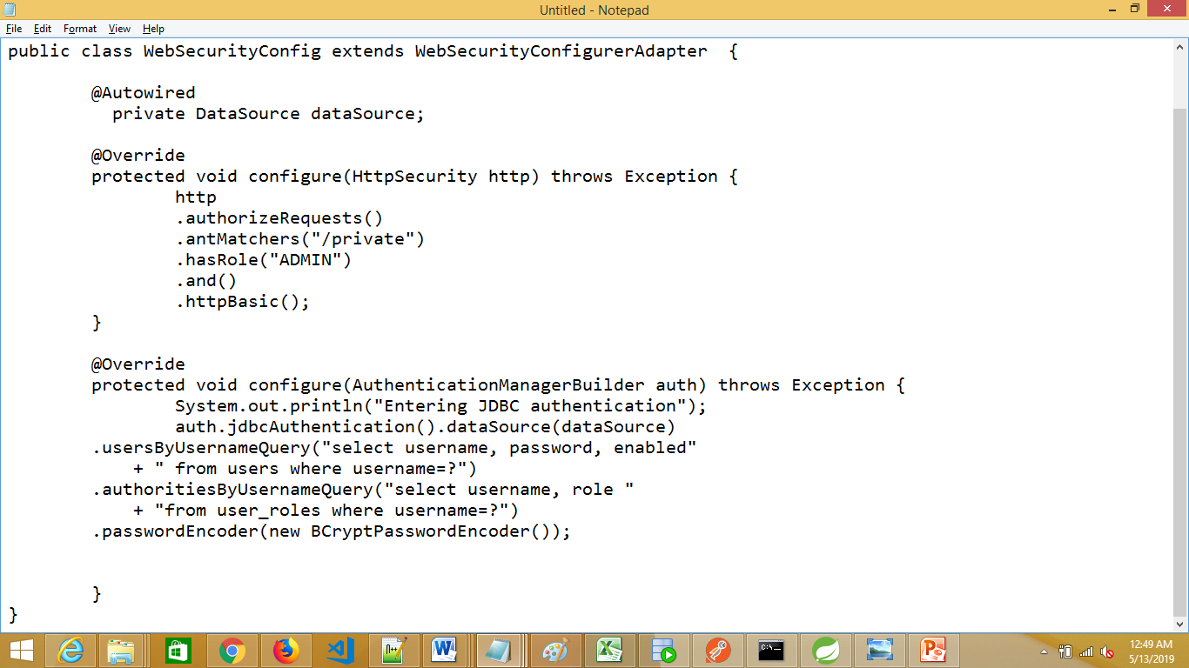
Program 11: Spring Security: Java Based Config JDBC Authentication
Modify WebSecurityConfig class to use jdbc authentication.

Slide 73
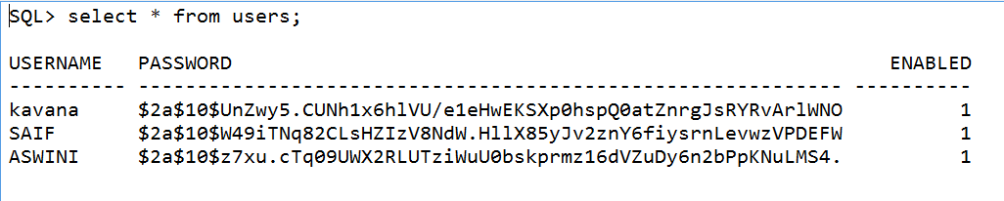
Program 11: Spring Security: Java Based Config – JDBC Authentication – Update encoded password in DB table
Since, we have used passwordEncoder as BCryptPasswordEncoder, you should get the encoded password and update that in the DB table

Slide 74
Program 11: Spring Security: Java Based Config – JDBC Authentication – Include AppConfig.java
Since, we have introduced AppConfig.java, we need to hook this file.
Modify MvcWebApplicationInitializer.java to update getRootConfigClasses() as follows:
@Override
protected Class<?>[] getRootConfigClasses() {
System.out.println("inside getRootConfigClasses");
return new Class[] { WebSecurityConfig.class, WebMvcConfig.class,AppConfig.class };
}

Slide 75
Program 11: Spring Security: Java Based Config – JDBC Authentication – db.properties file
Create db.properties file under /src folder
db.properties
==========
oracle.driver=oracle.jdbc.driver.OracleDriver
oracle.jdbcUrl=jdbc:oracle:thin:@localhost:1521:xe
oracle.username=system
oracle.password=Password123

Slide 76
Thank you

